Slide 1

Education, Advocacy, Resources

Slide 2
Virginia Caregiver Coalition. . .
is one of over 50 organizations across the Nation focused on meeting the growing needs of family caregivers.
started in 2004 and continues to grow with membership across the Commonwealth, attending meetings every other month using video conference technology.
participation is made up of public, private and non-profit organizations, universities and individual caregivers.

Slide 3
Our Mission. . .
VCC is working passionately to improve the experience of caregiving across the lifespan through education, advocacy and access to resources.
Our Vision. . .
All Virginia caregivers are valued, respected, and supported and will have easy access to information, education and services.

Slide 4
Who are caregivers and why are they important?
Virginia’s caregivers are 1.7 million strong and growing. They are the unsung real-life heroes and heroines providing over a million hours of care to loved ones – of all ages – who are chronically ill and/or disabled. Virginia’s caregivers help to keep parents, spouses, siblings and adult children in their homes and in their communities.
According to the AARP (Valuing the Invaluable: 2011 Update), the monetary value of Virginia’s family caregivers’ assistance totals over 11 million dollars. The combined efforts of every family caregiver throughout the Commonwealth represents a huge investment in the long term care of Virginia’s most vulnerable citizens.

Slide 5
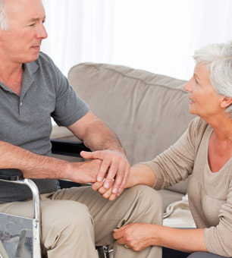
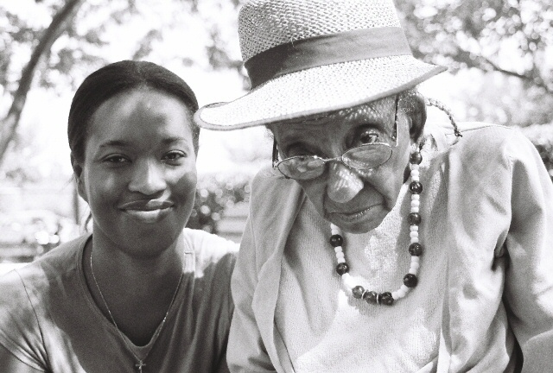
66% of Caregivers are female.
62% of Care Recipients are female with an average age of 61.
31% of Caregivers have been caring for a loved one for 5 years or more.
It’s personal. . .
Caring for my Grandmother is the most rewarding, and the same time, the most stressful thing that I have ever encountered in my life.

Slide 6
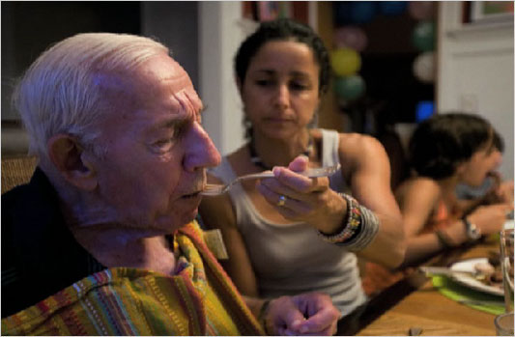
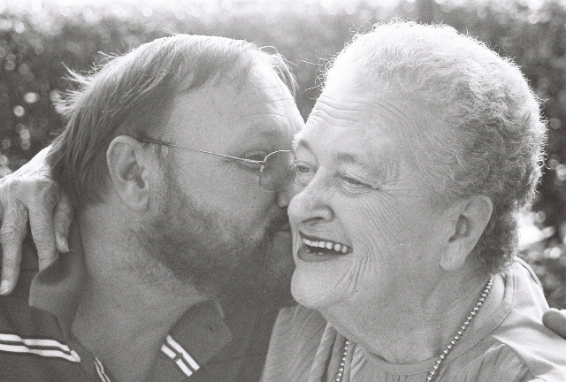
We will all be Caregivers or Care Recipients one day!
Average age of Caregiver is 48.
14% of caregivers are caring for an adult 18-49.
34% of Caregivers take care of 2 or more people.
14% are caring for a child under age 18.
We care because we love.” Donna and her son, Mike

Slide 7
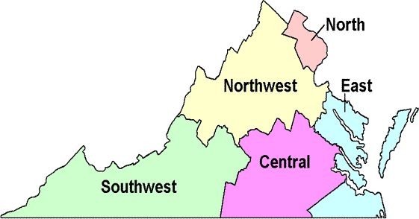
Education. . .
At it’s core VCC is a diverse and active community of caregivers and providers who meet every other month for networking, training, education, project brainstorming and resource sharing.
Presenters include researchers, physicians, professionals, agency representatives, and caregivers themselves all educating on a wide array of timely and important topics that can benefit caregivers and those providing services to caregivers.
Presentations are video-conferenced in real-time to multiple sites all over the state where professionals and caregivers alike are gathered and have the opportunity to participate with questions, comments and discussion.

Slide 8


Past Programs. . .
Ethical Decision making
Gadgets, Gizmos and Home Modifications
Elder Suicide
Medications and Aging
Caregiver Depression
Knowing When it’s Safe to Drive
Long Term care and Waiver programs
Benefits for Veterans
Living with a Spouse with Alzheimer’s Disease
Creating Successful Caregiver Programs
CPR, Artificial Feeding, Comfort Care and the Pt. with a Life-
Threatening Illness

Slide 9


Advocacy and Resources in action. . .
  Accessibility to membership and participation available through statewide videoconferencing technology.
  Creation of caregiver picture exhibit at
  the Virginia General Assembly Session.
  Ongoing partnership with Virginia Navigator
  to provide online information regarding resources for family caregivers.
  Training through the National Alliance for Caregiving.
  VCC authored Taking Care, A Resource Guide for Caregivers (http://www.caregiving.org/pdf/coalitions/VA_Caregiver_Guide.pdf)

Slide 10


Regular updates provided by state and local government officials to coalition members on legislation and proposals related to family caregivers.
Ongoing education to membership on research participation opportunities through Virginia universities on topics related to family caregiving.
In partnership with DARS and ARCH National Respite Network and Resource Center, VCC conducted Lifespan Respite Summit resulting in a proposal and subsequent award of Lifespan Respite Grant.
Ongoing support to DARS for Virginia Lifespan Respite Voucher Program providing up to $400 reimbursement for respite care services to individual caregivers.
Promotion of Family Caregiver month/day activities across the state.

Slide 11
Our ribbon of support. . .
Caregivers
Health Systems ∙ Universities
Virginia’s Area Agencies on Aging
Hospice Organizations
Faith-based Organizations
Adult Day Programs
Department of Aging and Rehabilitative Services
Centers for Independent Living

Slide 12
Benefits for members. . .
Free Membership and participation
Interdisciplinary collaboration
Education and Advocacy
Information about statewide legislation
Networking
Updates on local, regional and statewide Programs and Resources
Research Participation
VCC Needs You!
We invite caregivers, not-for profit and for profit organizations, colleges and universities, local and state agencies, businesses to attend our meetings, give presentations about your services and become members.
With your help we will continue the work of valuing, respecting and supporting caregivers across the Commonwealth of Virginia.

Slide 13
Meetings are the Third Thursday of Every other month.
For Video Conferencing location in your area contact: # 804-662-9340 or Email: Ellen.Nau@dars.virginia.gov

